Slide 1
Info 201 :Final project presentation
By Tony, Ziyang,Justin, Clive

Slide 2
Content
1, Introduction
2, Overview of Data
3, Analysis & Research question
-The distribution of gun violence in each state in US
-The relationship between gender and gun violence
-The relationship between wealth and gun violence
-The relationship between number of firearms and gun violence

Slide 3
What and why are you doing this:
What are you doing?
Firstly, we aim to examine the relationship between gender and gun violence, investigating differences in involvement and victimization rates among genders. Secondly, we delve into the correlation between wealth, as indicated by GDP per capita, and gun violence, to understand how economic status affects gun-related incidents. Thirdly, our study will analyze geographical disparities by assessing the relationship between different U.S. states and the prevalence of gun violence, considering regional factors such as local gun laws and socio-economic conditions. Lastly, we seek to explore the distribution of gun violence in relation to the number of firearms, aiming to uncover whether a higher concentration of firearms correlates with increased gun violence.
What is your target group?
-Researchers and Academia,
-Politicians or policymakers,
-Public students, and citizens, International tourist,
-Law Enforcement , General public
What may they gain from your work
They may gain valuable insights that could inform effective strategies for public safety and policy development. uncovering patterns and insights that contribute meaningfully to the understanding of gun violence in the United States.

Slide 4
Overview of data:
Where did you get the data?
Gun Violence Dataset(2021) US: CDC compiles and reports firearm mortality data.
Source:https://www.cdc.gov/nchs/pressroom/sosmap/firearm_mortality/firearm.htm
Sex Ratio Dataset(2021) US: KFF gathers demographic information, including sex ratio.
Source: https://www.kff.org/other/state-indicator/distribution-by-sex/?currentTimeframe=1&sortModel=%7B%22colId%22:%22Location%22,%22sort%22:%22asc%22%7D
Real GDP per Capita Dataset(2022) US: Statista collects economic data, specifically real GDP per capita.
Source: https://www/statista.com/statistics/248063/per-capita-us-real-gross-domestic-product-gdp-by-state/
Number of Registered Weapons Dataset(2021) US: Statista compiles data on the number of registered weapons.
Source: https://www.statista.com/statistics/215655/number-of-registered-weapons-in-the-us-by-state/
What about data quality, and reliability?
Reliability
Any ethical issues you see with using these data?
Privacy Concerns

Slide 5
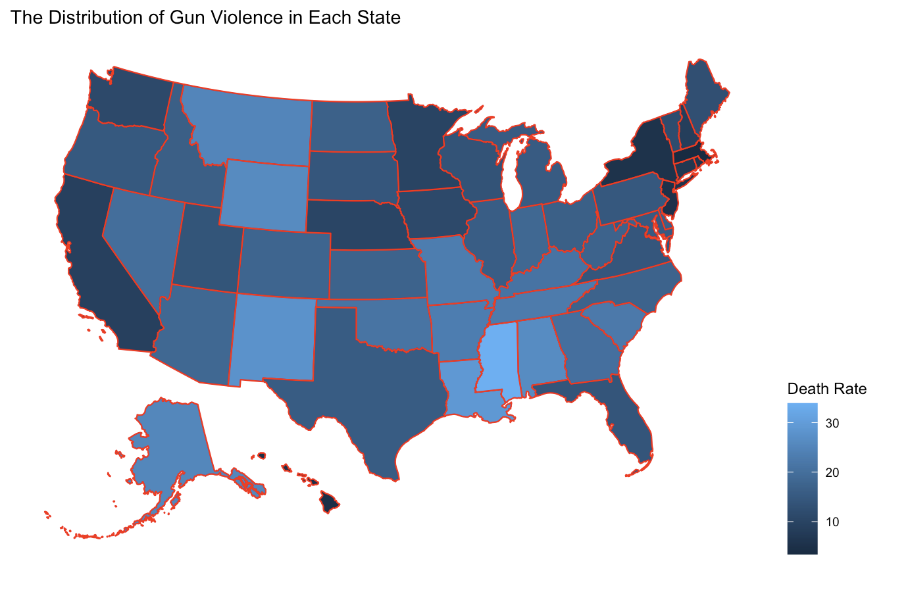
1.The distribution of gun violence in each state in US

Slide 6
Draw conclusions from your data/analysis
the results from this analysis contribute valuable information to the broader discussion on gun violence in the United States, offering a geospatial and quantitative perspective that enhances our understanding of the distribution of incidents at the state level in 2021.

Slide 7
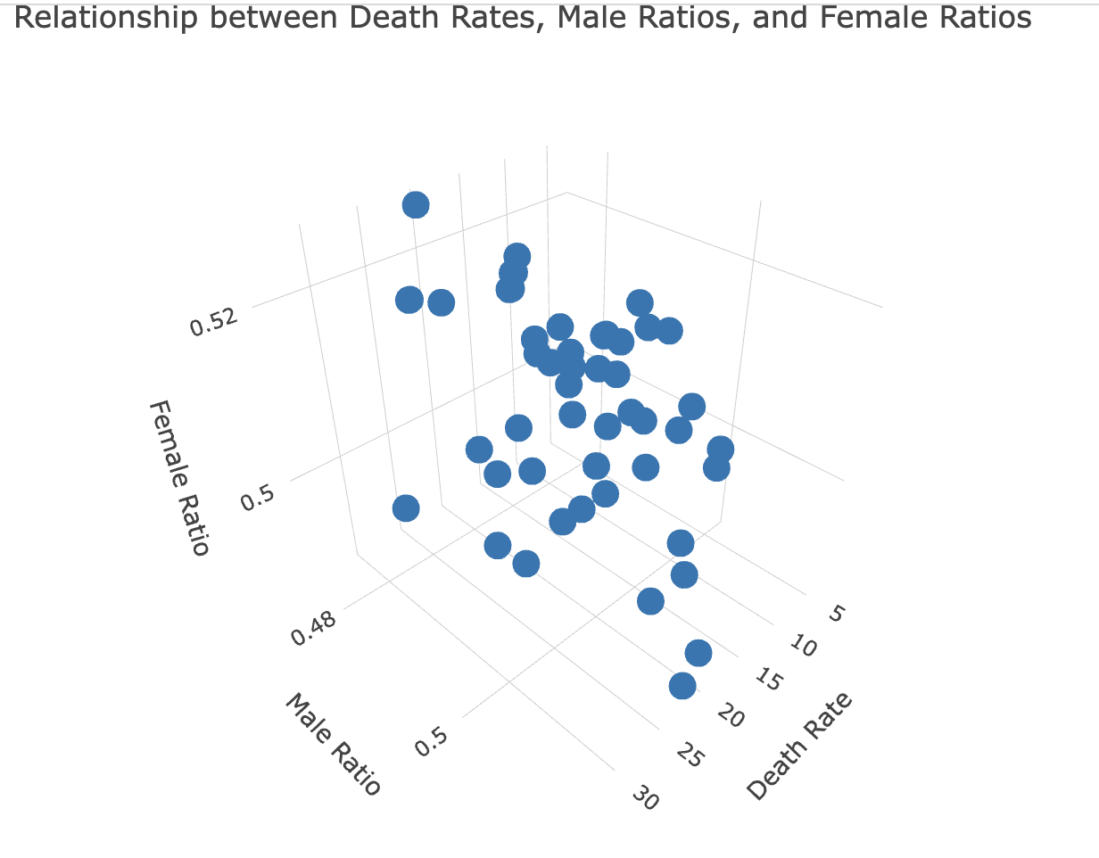
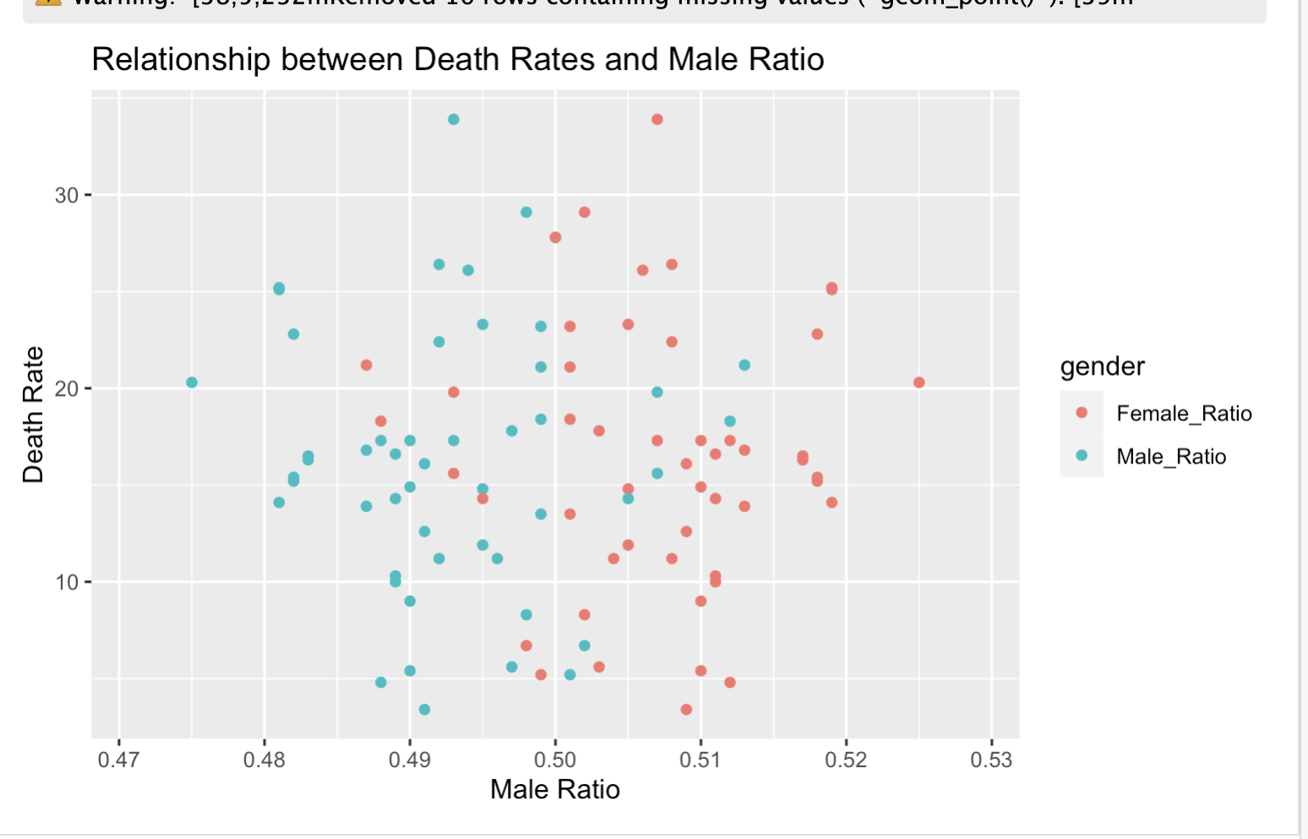
2. The relationship between gender and gun violence

Slide 8
Draw conclusions from your data/analysis
I think the data didn’t tell us about correlation relationship between male ratio, female ratio and death rates. There is no connection between two variables..Based on the graph, we can’t find strong correlation and causation, I think the result is totally opposite than what we expected in the beginning of final project.we used to predict that comparatively high female ratio zone, the death ratio would be lower than the zone where have more male.

Slide 9
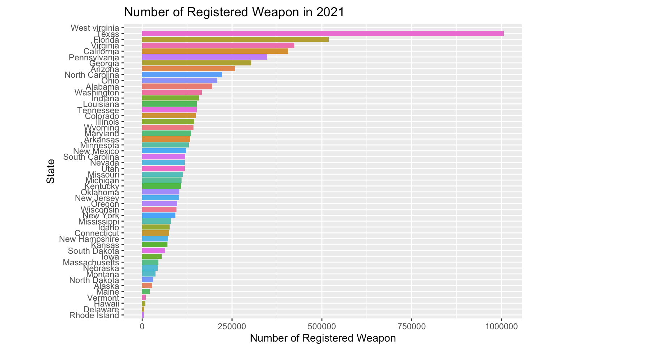
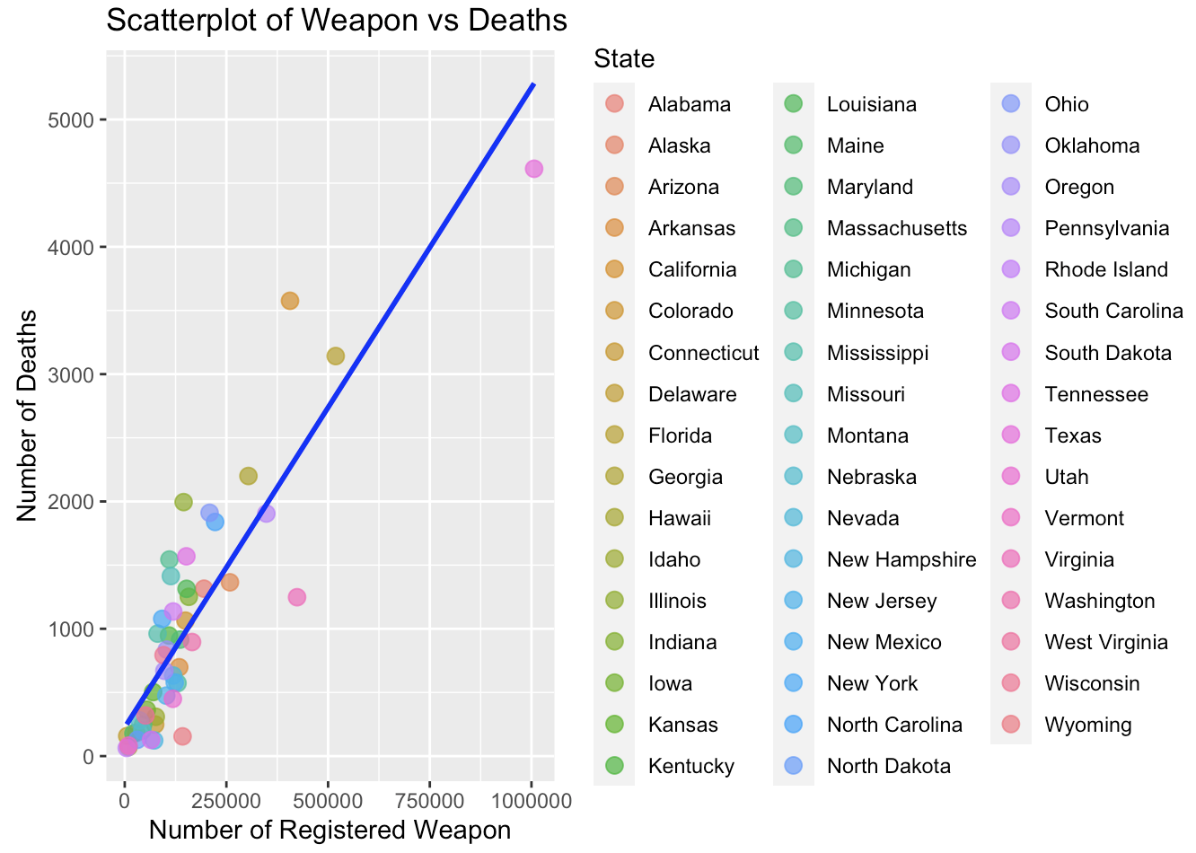
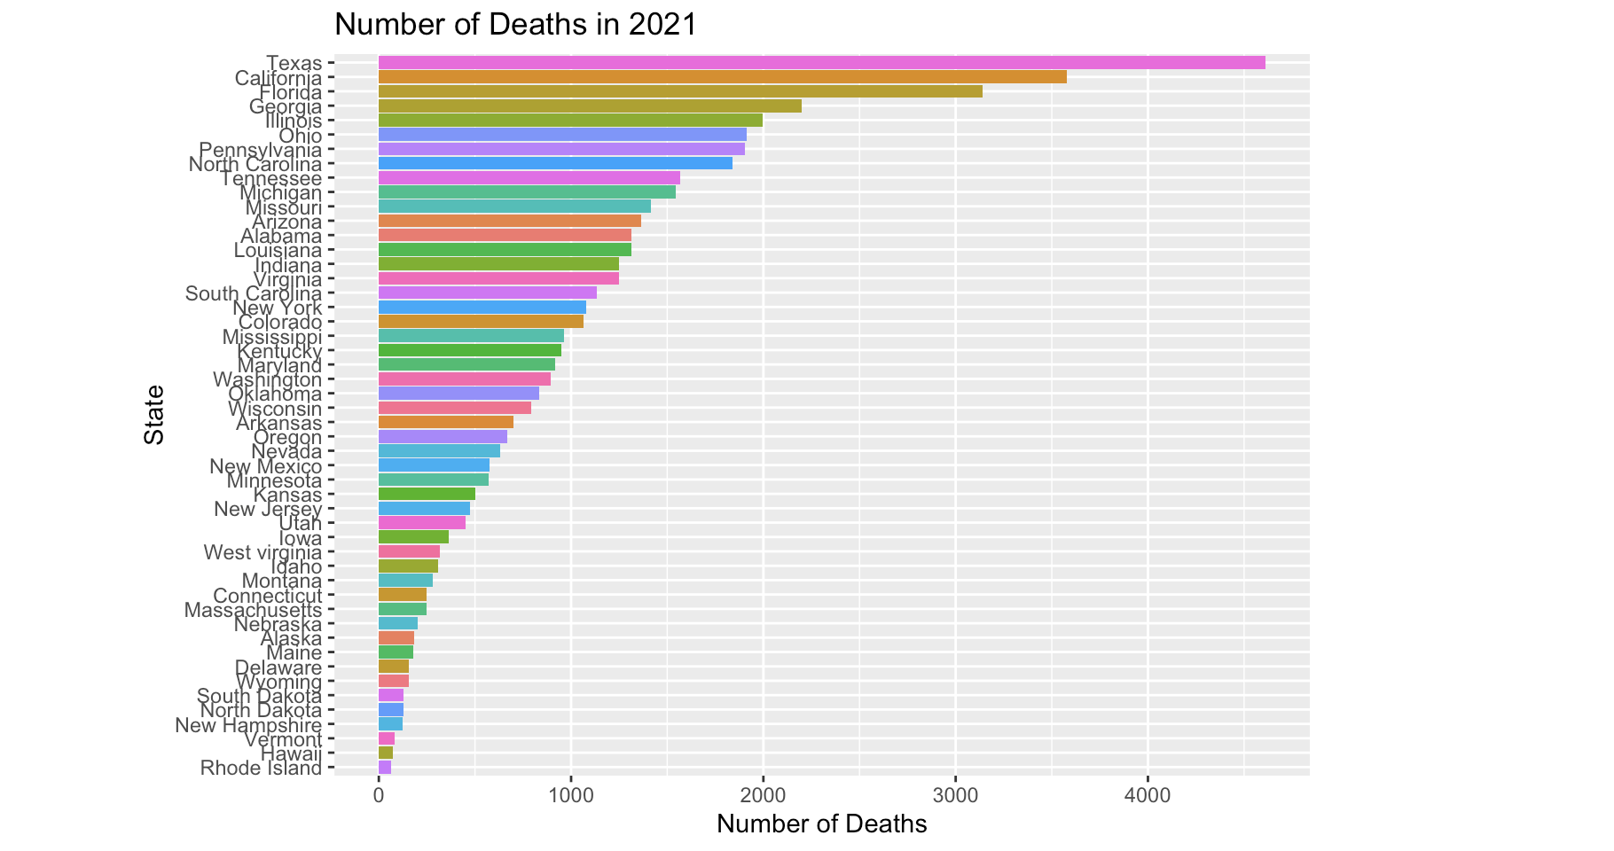
3.The relationship between number of firearms and gun violence

Slide 10
Draw conclusions from your data/analysis
As stated in the previous hypothesis, the number of guns is directly proportional to the gun fatality rate. States such as Florida or Texas with a high number of firearms distribution have high shooting casualty rates, while remote areas like Rhode Island, which do not have many guns, do not have as many shooting casualty rates. This further supports this hypothesis.

Slide 11
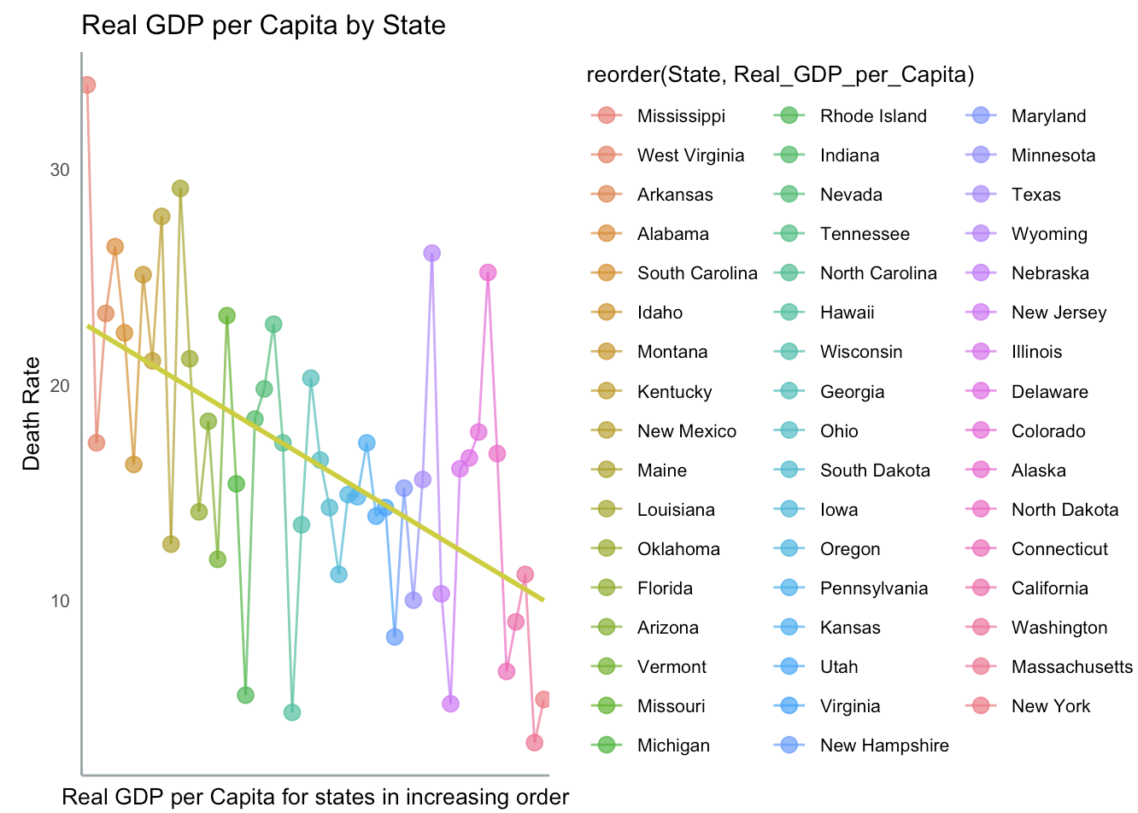
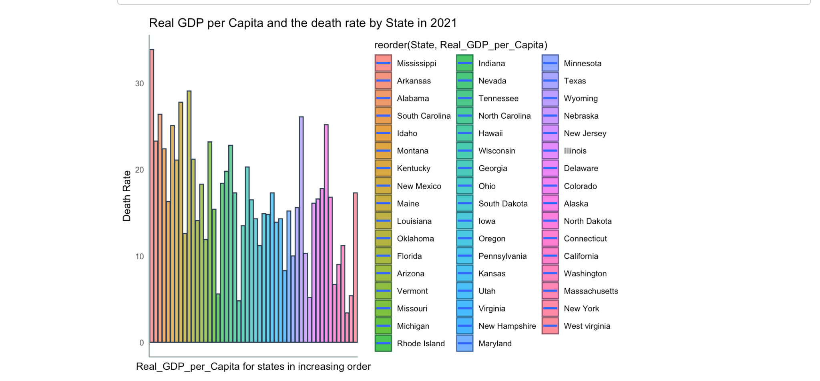
4.The relationship between wealth and gun violence

Slide 12
Draw conclusions from your data/analysis
As we can see form the data messipie had the highest death rate and form the right side new York and Washington states are all low according this and the slope we can get it is true which proved our hypothesis. the results from this analysis contribute valuable information to the broader discussion on gun violence in the United States, offering a geospatial and quantitative perspective that enhances our understanding of the distribution of incidents at the state level in 2021.

